Slide 1
Public Private Dialogue as Basis for Partnerships
An Example: Food Fortification

Slide 2
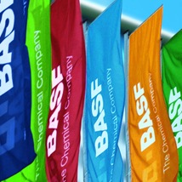
1. BASF – The Chemical Company
The Company at a Glance

Slide 3
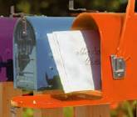




BASF – The Chemical Company
Overview
  Our Corporate Purpose: We create chemistry for a sustainable future.
  The world’s leading company in chemical industry
  Offers intelligent system solutions and high-value
  products for almost all industries
  Sales 2012: € 72.129 billion
  More than 110,000 employees
Notes:
We are the world’s leading chemical company – The Chemical Company. More than 110,000 employees work in the BASF Group toward contributing to the success of our customers from nearly all sectors and almost every country in the world.
Source: BASF Report 2012, page 18, updated.
BASF posted sales of approximately €72.1 billion in 2012. BASF shares are traded on the stock exchanges in Frankfurt (BAS), London (BFA) and Zurich (AN). . Further information on BASF is available on the Internet at www.basf.com.

Slide 4
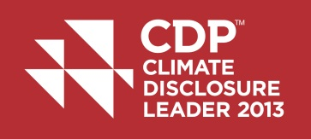
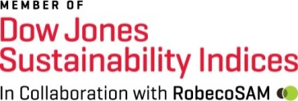


BASF – The Chemical Company
Sustainability Selected Awards
Carbon Disclosure Project
Climate Disclosure Leader 2013
Dow Jones Sustainability Index
BASF share included in DJSI World for 13th consecutive year
China Green Companies Top 100
BASF honored for its commitment
LEED (Leadership in Energy and Environmental Design)
BASF honored for sustainable construction
Notes:
In September 2013, BASF was again included in the global Dow Jones Sustainability Index (DJSI World) and CDP Global 500 Climate Disclosure Leadership Index (CDLI).
The BASF share is included in the DJSI World for the 13th consecutive year. The company has been recognized for its engagement in risk and crisis management, human capital management and the progress regarding ecoefficiency analyses in its own operations.
The DJSI World is one of the most renowned sustainability indices and represents the top 10 percent of the largest 2,500 companies included in the Dow Jones Global Index.
According to CDP, an international organization that compiles environmental information from companies, BASF is among the leading companies in climate protection reporting worldwide. The company is listed in the CDP Global 500 Climate Disclosure Leadership Index (CDLI) for the ninth time. The CDLI 2013 contains 60 companies that disclose their data in a particularly transparent and comprehensive manner. As in previous years, BASF is the top scorer in the Materials sector.
China Green Companies Top 100: For the fifth time in succession, BASF was listed among the China Green Companies Top 100. This award recognizes companies that strengthen their competitiveness through long-term commitment to environmental protection, society, innovation and corporate culture.
LEED: BASF’s new North American headquarters in Florham Park, New Jersey, was awarded the highest LEED certification in 2012, making it one of a total of five construction projects in the United States to have achieved the Double Platinum rating. The classification system for sustainable buildings defines standards in the areas of site concept, water and energy consumption, building materials and interior construction.
Source: BASF Report 2012, cover.

Slide 5

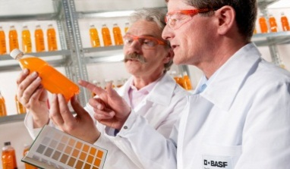
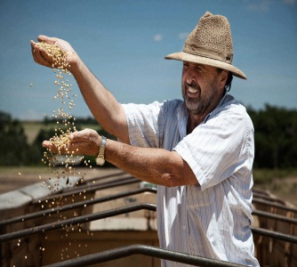
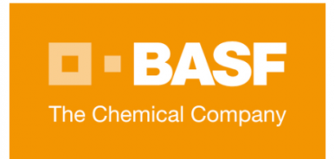
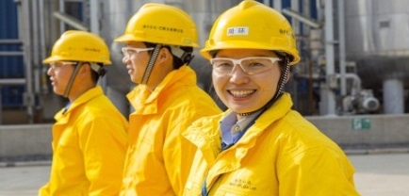
BASF – The Chemical Company
Dialogues and Platforms
The Concept of Co-Creation
BASF relevant public
Scientists
Customer / Partners
Creating value together
with our stakeholders
Employees
Internal co-creation: leverage collaboration among employees to generate ideas and/or solve problems
External co-creation: involve customers, suppliers, partners, scientists and other relevant stakeholders to generate value for all parties
Source: Project "150"

Slide 6


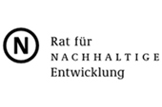













BASF – The Chemical Company
Dialogues and Platforms
Sustainability requires dialogue and partnership with stakeholders
Multi-stakeholder
initiatives
Business associations &
networks at corporate level
Bi-lateral stakeholder consultations

Slide 7



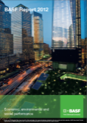

BASF – The Chemical Company
Dialogues and Platforms
Sustainability requires dialogue and partnership with stakeholders
Chemistry³ - The Sustainability Initiative of the German Chemical Industry
Integrated Reporting on Sustainability
Agro-Political Initiative:
Samruddhi – Prosperity for the Customer, Prosperity for the Organization and Prosperity for India
Notes:
Im Jahr 2007 hat BASF mit Samruddhi (zu Deutsch: „Wohlstand“) ein Schulungsprogramm für indische Landwirte ins Leben gerufen, das sie dabei unterstützt, erfolgreich ein nachhaltiges Geschäftswachstum zu erzielen. Samruddhi wendet sich mit einem ganzheitlichen Ansatz an Landwirte und ermöglicht es, die Produktivität von Nutzpflanzen wie etwa Soja zu erhöhen.

Slide 8

2. Food Fortification
Concepts & BASF Contributions

Slide 9
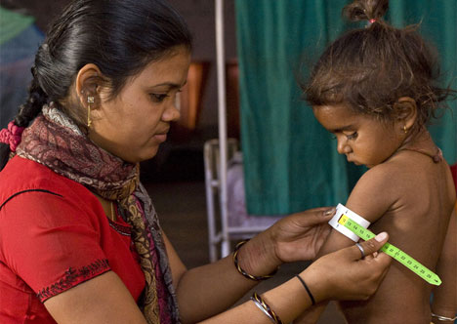
Food Fortification
Facts and Figures
In the next 12 months, vitamin and
mineral deficiencies will cause:
1 million children to die before the age of five
50,000 women to die
during or soon after childbirth
19 million infants to be born
with impaired mental capacity
100,000 infants to be born
with preventable physical defects
6 billion US$ to be lost in adult work performance
Since 2004, the Copenhagen Consensus have consecutively rated addressing vitamin and mineral deficiencies as one of the best investments into human development - from a cost-benefit perspective

Slide 10
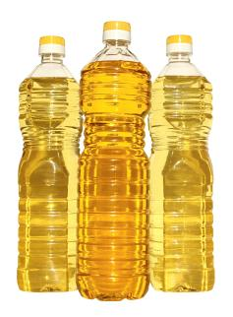


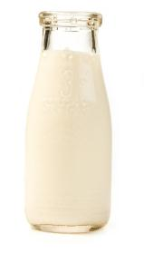

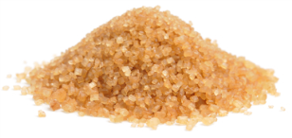
Food Fortification
The Process
Food-Fortification is the practice of deliberately
increasing the content of an essential micronutrient,
[…] in a food, so as to improve the nutritional quality
of the food supply and provide a public health benefit.*
In food fortification, private sector activities
are aligned with public sector/NGO engagement.
Essential
Micronutrients
Vitamin A
Iron
Iodine
Zinc
Common
Food Vehicles
Edible oil
Flour
Rice
Milk
Sugar
* Source: “Guidelines on food fortification with micronutrients”, WHO & FAO

Slide 11





Food Fortification
Complementing Interventions
Short
term
Supplementation
Supplements with highly concentrated vitamins and minerals
in form of capsules, tablets or food-based sachets (“SprinklesTM”)
Implemented as part of health care or targeted campaigns
Medium
term
Vitamins
&
Minerals
Food Fortification
Reaches large numbers of consumer
Eating habits can be maintained
Market-based application
Independent of public health financing
Long
term
Dietary diversification
Implemented through behavioral change
Diversification in agricultural food production often necessary
Depends on purchasing power and knowledge/education
Time and cost intense

Slide 12

Food Fortification
Business Case: Shared Value
CSR
Partnerships
Market
access
Employer
Branding
Innovation
Communication
Business success
Dual Bottom Line benefits estimated 1.5 times of sales value
Purely humanitarian projects are done by the BASF Social Foundation

Slide 13
Food Fortification
Clock Model for Project Sequences
Test Kits
Baseline Data
Four Steps to Large-Scale Impact
Stakeholder
Dialogue
  Advocacy
  Technical Trails
  Voluntary Fortification
  Law & Compliance
Law & Compliance
Advocacy
Legislation
Media
Voluntary
Tech. Trials
Analytics
Labelling
Tech.
Training
Standards
Pilots

Slide 14
Food Fortification
Managing Multi-Stakeholder Programmes
An efficient food fortification programme requires multi-stakeholder dialogues
BASF
Collaboration
&
Dialogue
Local food producers (private sector)
carry out market-based programme implementation.
Government agencies
(public sector)
aim to solve a public health problem through food fortification.
Local research institutions
(academia)
deliver scientific data on the impact of malnutrition for the sake of programme evaluation.
NGOs (social sector)
represent consumers' interests and often campaign using social marketing.

Slide 15
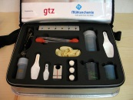

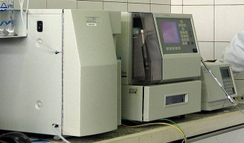
Food Fortification
Technical Supply and Support
Company Level Quality Control
External Quality Control
Producers:
In-house Quality Check
FDA/Bureau of Standards:
Screening
Laboratories:
Control
Number
of samples
Screening
with Test Kit
Screening
with Test Kit
HPLC
(High performance liquid
chromatography)
$ 8 – 15
$ 50 – 100
$ 0.05 – 0.10
→ BASF Test Kits offer a cost-effective approach to company quality checks to complement external quality control

Slide 16
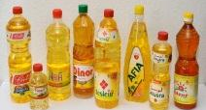

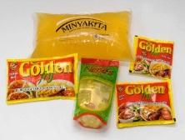
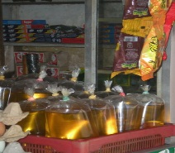
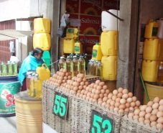
Food Fortification
Reaching the Base of the Pyramid
Reach in the
target group
Upper market segment
snacks, milk,
bottled oil …
Middle class
pouches
§
BoP
barrels
→ Same products differ in packaging material and size depending on BoP segment

Slide 17
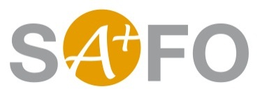
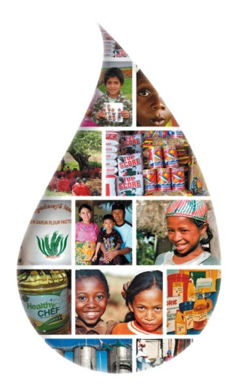
Food Fortification
The Example of SAFO
Objective: Improve access by low-income population groups to vitamin A –fortified staple foods
GIZ | BASF
Facilitation of multi-stakeholder dialogue | Technical advice for fortifying food producers
Capacity building of national institutions | Improve development of business models
Advice governments to develop local industry standards and labeling schemes | Offer analytic training, provision of mobile laboratory equipment
Advice governments on the introduction of legislation | Provide product & packaging solutions
STRATEGIC ALLIANCE FOR
THE FORTIFICATION OF OIL
AND OTHER STAPLE FOODS
Result
SAFO has reached 140 million people at risk of malnutrition
Nutrition re-positioned in German Development Cooperation

Slide 18
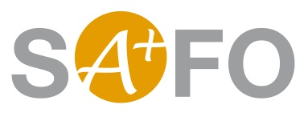
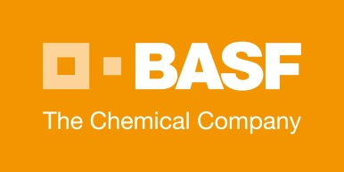
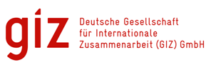
Food Fortification
Partnership Solutions
Private Sector
Public Sector
Mutual
benefit
Differing
motives
Diverging
interests
Common goal
Complementing
Contributions

Slide 19

Food Fortification
Further Partnership-Projects
Competitive African Rice Initiative (CARI)
Better Rice Initiative Asia (BRIA)
Oilseed Initiative Africa (OIA)
Potato Initiative Africa (PIA)

Slide 20
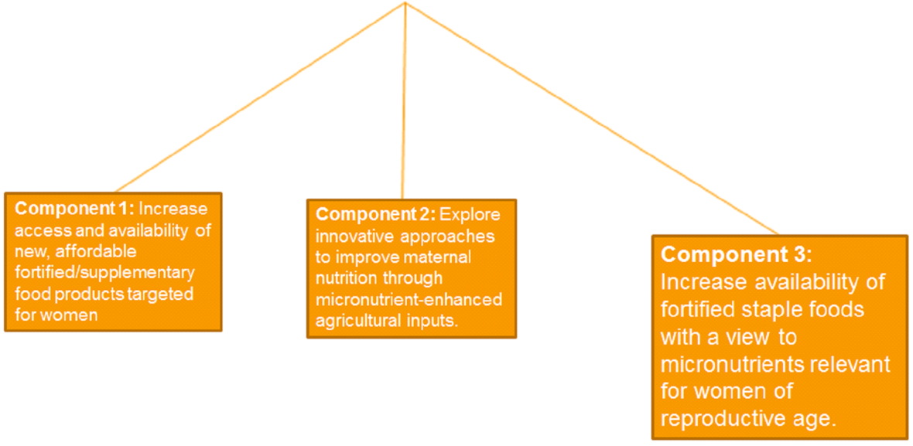
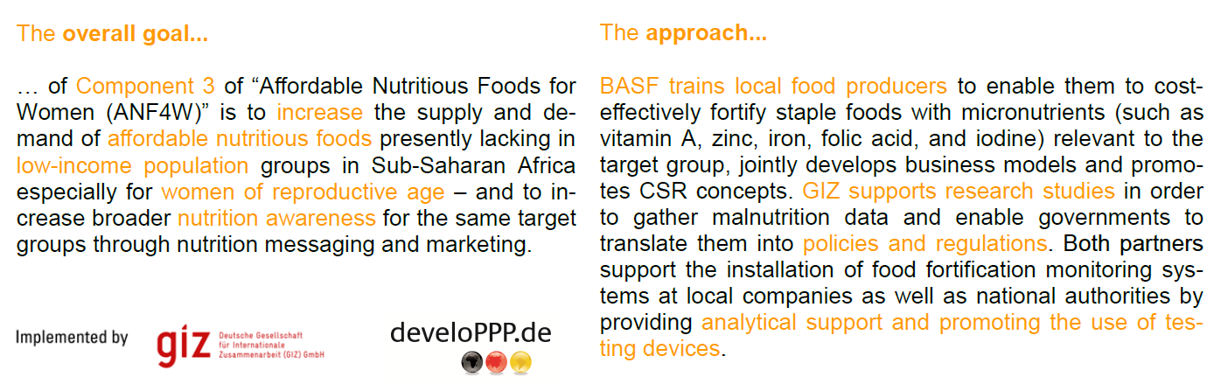
Affordable Nutritious Food For Women (ANF4W)
Food Fortification
Further Partnership-Projects

Slide 21

Imagine essential nutrition affordable for everyone.
www.food-fortification.com

