Slide 1
4 March 2014
Notes:
1
Commissioner of Economic Planning; Kaduna State

Slide 2
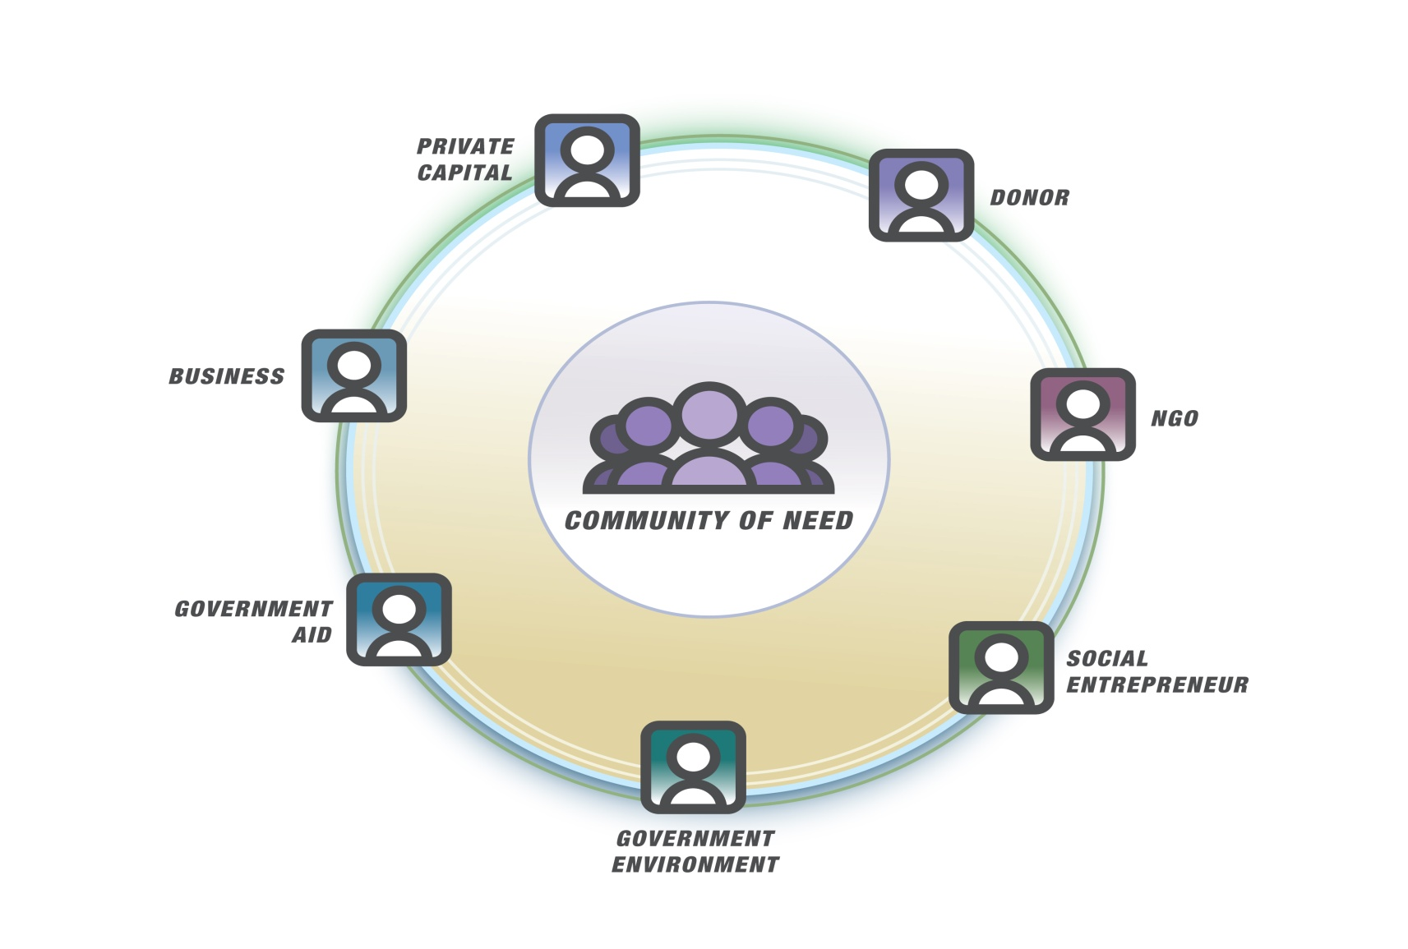
A Global, On-Line, Customizable Project Management Tool for PPD Coordination Units
Outcomes >
Transparency >
Learning

Slide 3
Easily configure system to the way you and your partners work (org, terms, work flow, roles/security, measures, forms, etc.).
Create, capture and manage a program across multiple stakeholders.
Define &monitor activities, indicators, tasks, budgets, etc. Manage lifecycle for discipline, accountability & learning.
Conduct formal evaluations, story-telling, and related learning endeavors throughout the lifecycle.
Use automated impact reports, a library of other reports of create custom reports. Update and track organizational standards, guides, etc. with learnings.
Notes:
Defining goals, theory of change, IBA, etc.
Define approach, resources, etc.
Select team: partners, staff, contractors, etc.
Manage the initiative: programs, projects, activities, tasks, etc.
Monitor the initiative: specific indicators for impact, outcomes, etc. rolled-up across sectors, partners, geographies, etc.
Evaluations: design, management, outcomes, impact, etc.

Slide 4
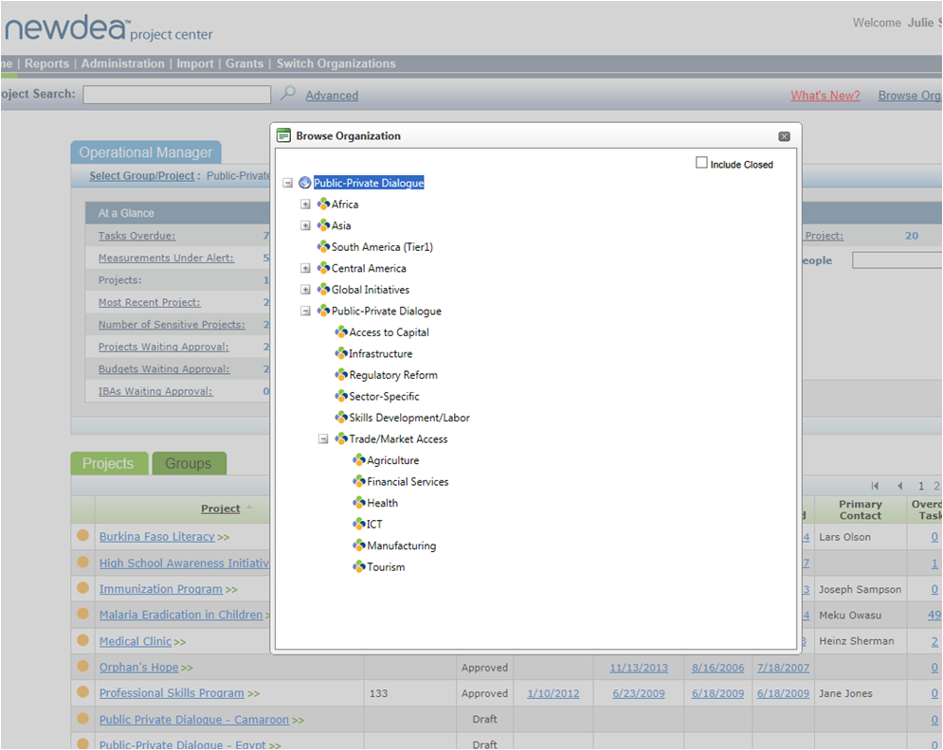
Structure Your PPD Programs
Structure
Structure programs as you desire.
Get straight to the details of any program… right at your fingertips... from anywhere.

Slide 5
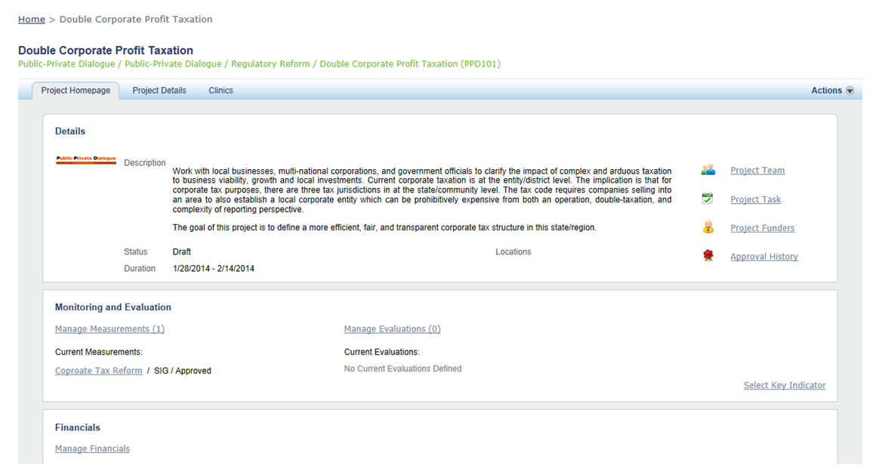
Collect & Manage Reform Proposals
Manage
Define your programs on your own terms.
Collaborate with stakeholders.
Track activities and progress.
Capture reform proposal details
Define partners, team members and roles – and track tasks for accountability
Track reform proposal status

Slide 6
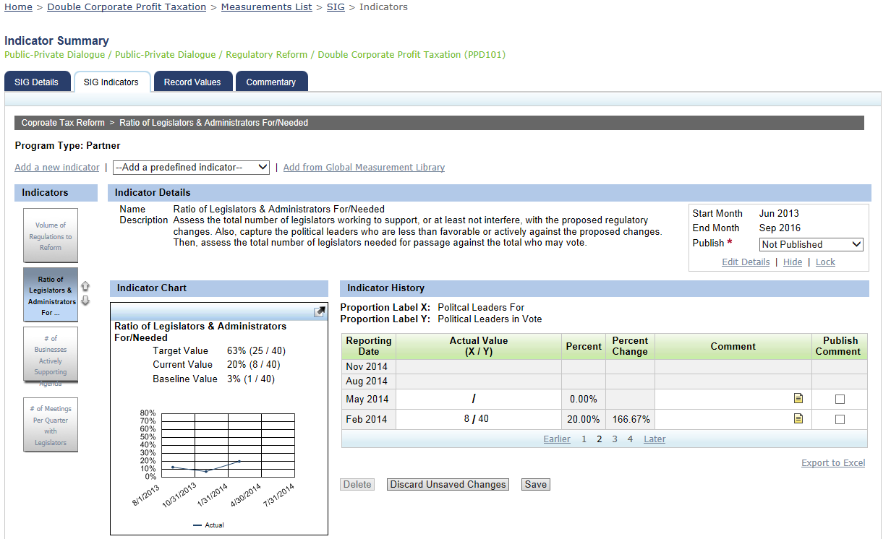
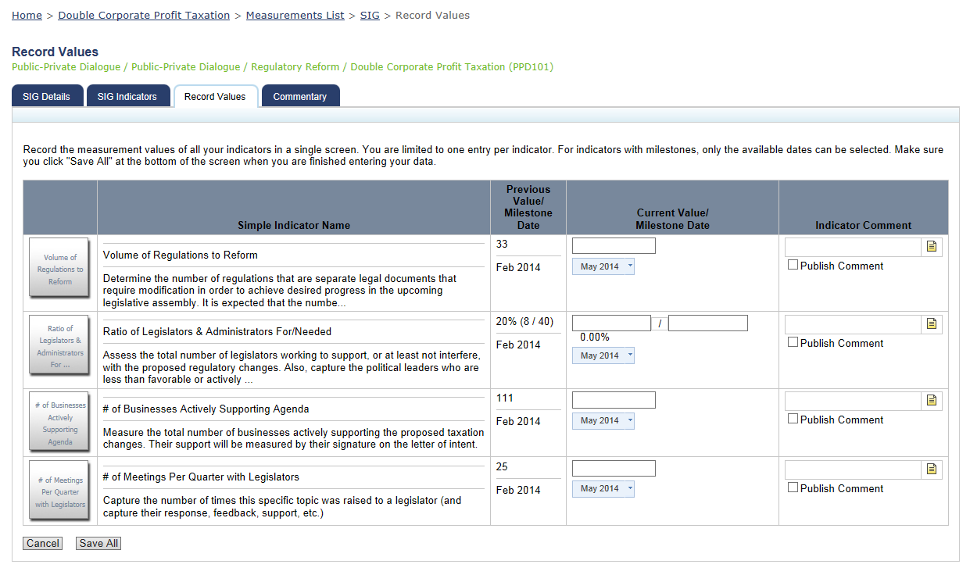
Comprehensive M&E Tool for Your PPD Programs – Monitoring
Monitor
Define M&E plans and deploy a data collection tool for key indicators and other data (pictures, stories, etc.)
Create custom indicators…
Select standards from the organization’s library
Define baselines, set targets and support real time data capture
Quick trend visualization
Capture information, not just data

Slide 7
Comprehensive M&E Tool – Evaluations for Reforms, Tasks & Actions
Evals
Conduct evaluations over the program’s life.
Track programs and partners for accountability.
Ensure transparency to all stakeholders.

Slide 8
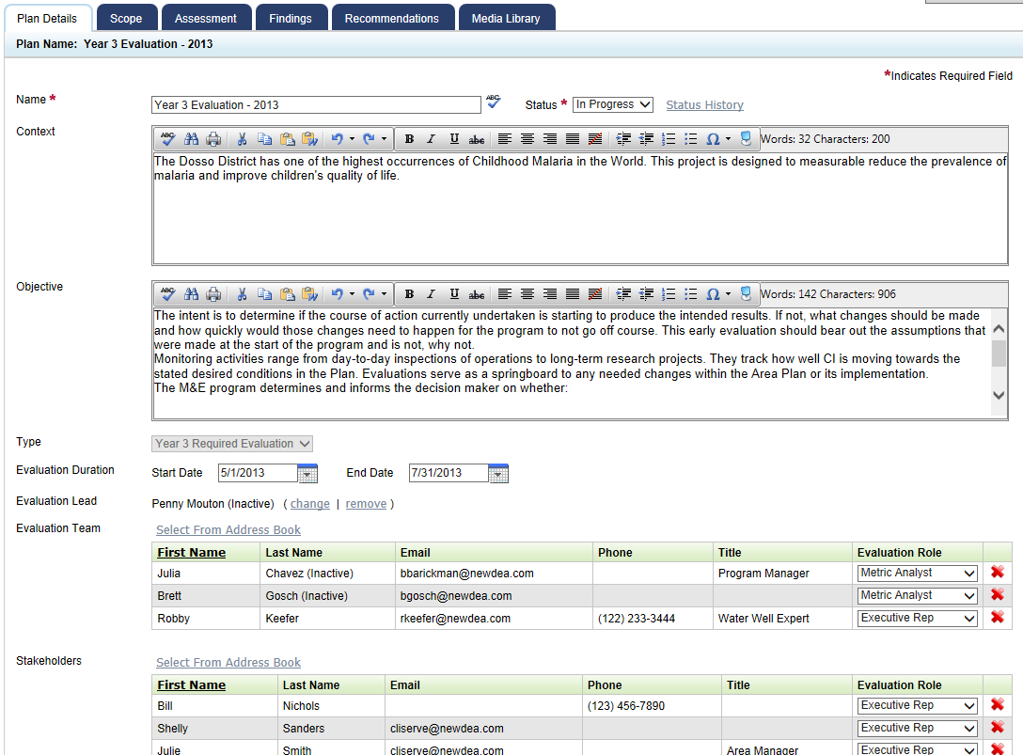
Comprehensive M&E Tool – Evaluations for Reforms, Tasks & Actions
Eval.
Clarify the context, objective, duration, etc.
Define evaluation team, stakeholders and methodology

Slide 9
Enable and Drive Learning for PPD Stakeholders
Eval.
Classify, prioritize and track follow-tasks & learnings for collective impact
Capture specific recommendations

Slide 10
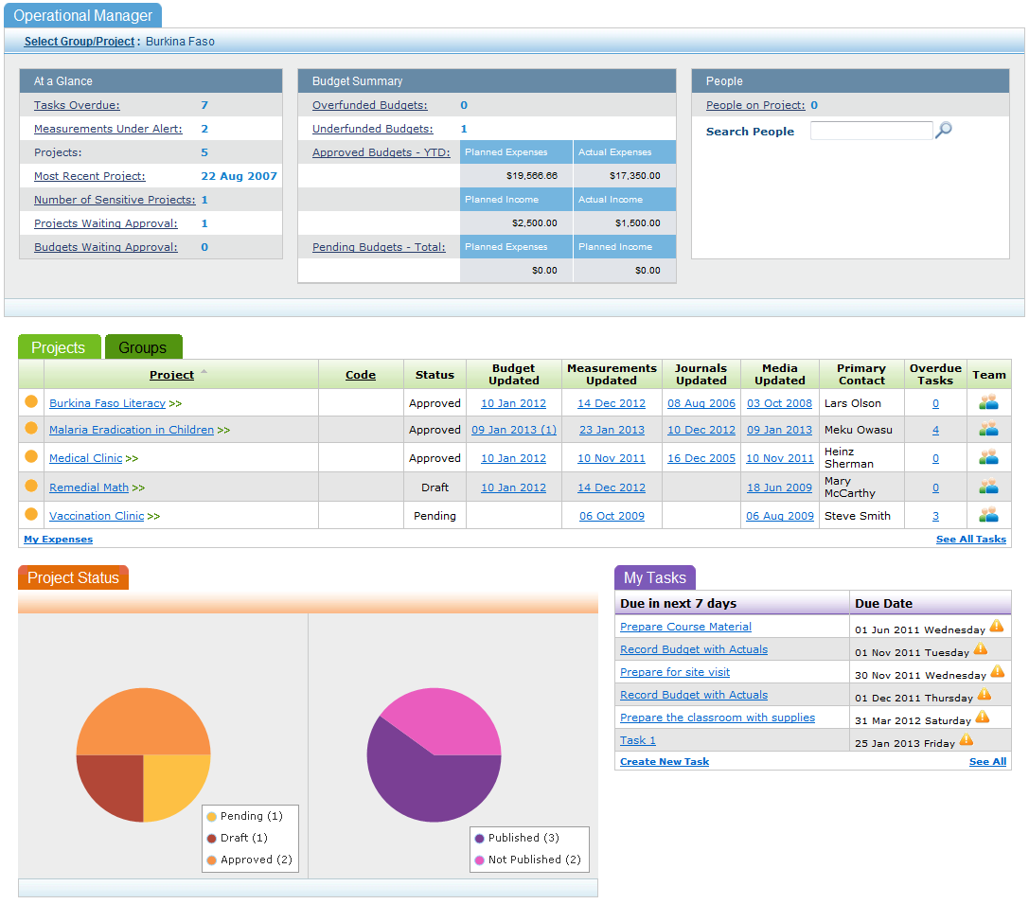
Role-based dashboards: Aggregate & summarize information across PPD geographies, sectors, programs, etc.
Reporting

Slide 11
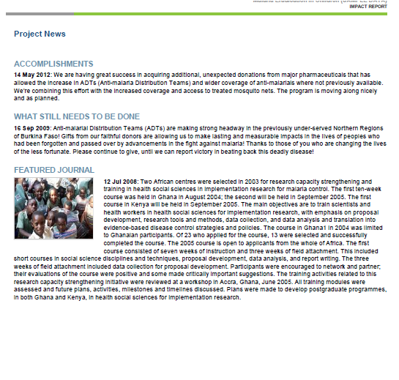
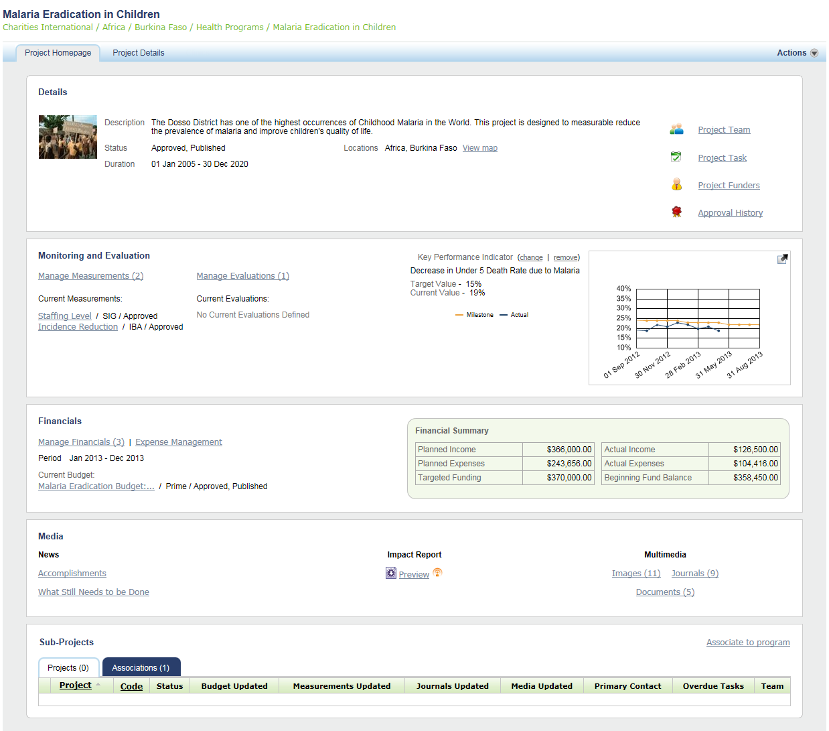
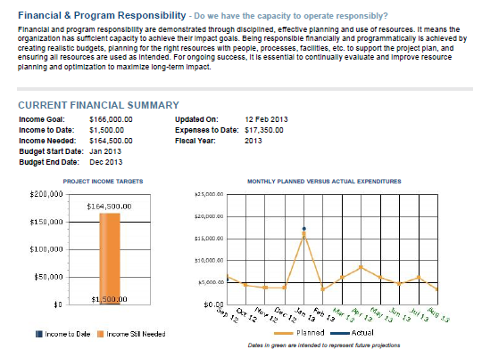
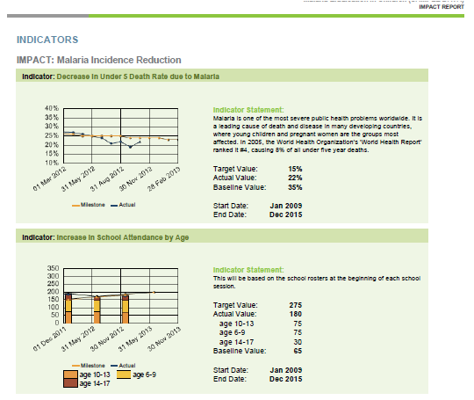
Sample Project Dashboard
Reporting
Track PPD endeavors, implementation approach, team members, etc.
M&E activities and key indicators
Track income/revenue, budgets and actuals
Capture the “human element” and automate reporting
Delegate with alignment and accountability

Slide 12
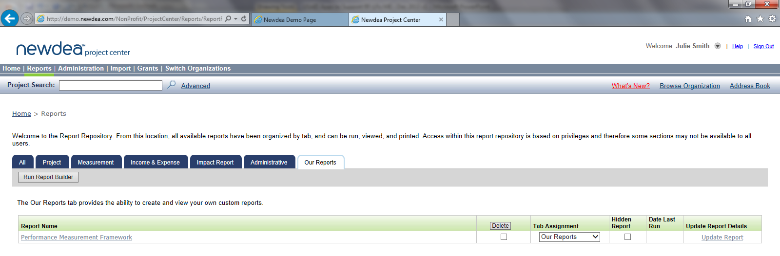
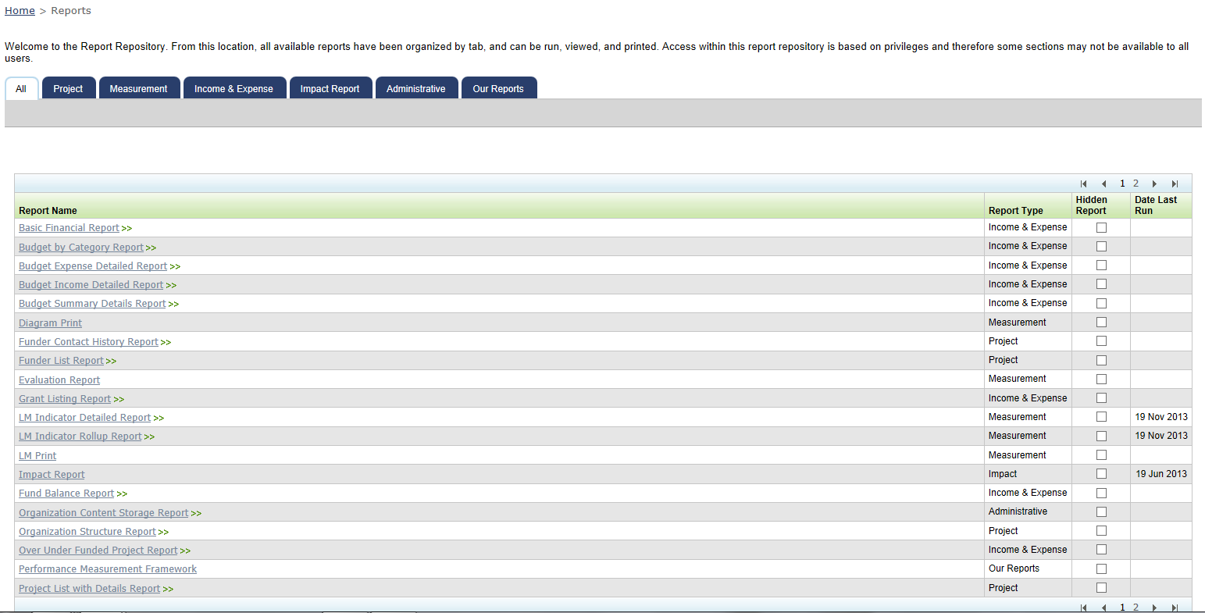
Efficient Reporting – Internally & Externally for Transparency
Reporting
… and create custom reports against your organization’s data
Summarize projects and expenditures by any category/structure desired (projects, geography, sector, etc.)

Slide 13
Newdea has partnered with The World Bank, allocating 200 licenses/seats to the PPD endeavor. The first organizations to sign-up and complete training will receive free licenses for one year. Training costs are paid by each PPD Coordination Unit.

Slide 14
To Learn More…
Four webinar sessions scheduled for in-depth demonstration and discussion:
0200 – 0330 GMT (convenient for Asia)
Tuesday, 18 March
Thursday, 27 March
1400 – 1530 GMT (convenient for NA, SA, EU, Africa)
Thursday, 20 March
Tuesday, 25 March
Register for a webinar by e-mailing us at training@newdea.com

