Slide 1

The Online Issue Tracker
7th PPD Global Workshop: Public-Private Dialogue for Sustainable Business. Frankfurt, Germany
Véronique Salze-Lozac’h, Economic Development
March 4, 2014

Slide 2

A web-based software
An issue-based record of PPDs and working groups activities:
Record key information on each issue selected
Set issue-specific objectives (with indicators)
Keep track of actions taken / progress made
Collect data for monitoring and evaluation purposes
What is the Issue Tracker?

Slide 3
Purpose of the Issue Tracker
  Issue monitoring and outcome/impact measurement tool
  Real-time platform for documenting actions made towards the resolution of each issue
  Allow to present progress made in a transparent, easily accessible way to sustain momentum
  Repository from which to collect and share data, experiences, and insights
  Allow users to draw inferences on patterns and trends

Slide 4
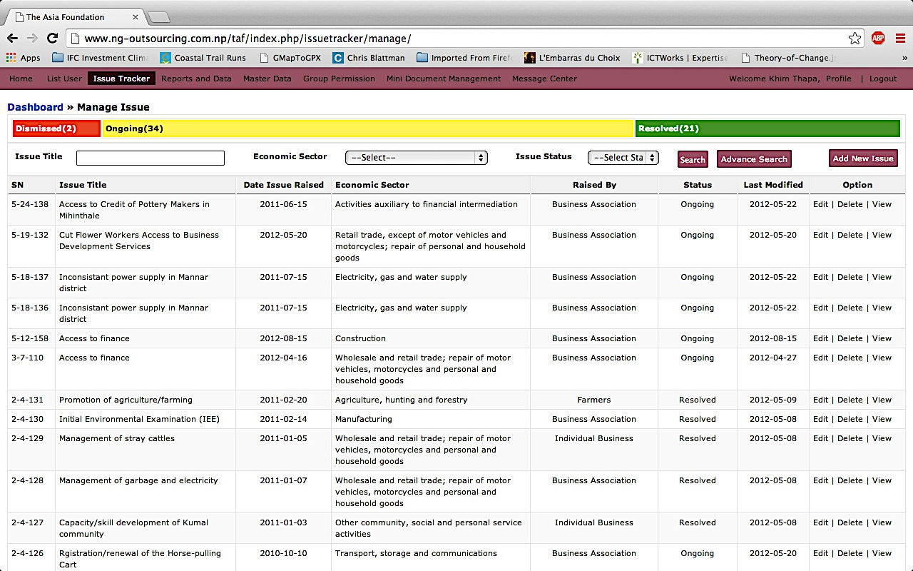
Online Issue Tracker

Slide 5
How does it work?
  One ISSUE – One ENTRY:
    Relocation of leather industry in Dhaka
    Export procedures for garment sector exporters
    Environmental tax in provincial Cambodia
    City garbage collection in in Sri Lanka
    Etc.
  Important data (sector, geographical location, policy issue, relevant/involved stakeholders, etc.) can be captured in one place

Slide 6
How does it work?
  Flexible to organization of working groups needs (e.g., by sector, geographical location, policy issue, etc.)
  As a monitoring and evaluation tool, it compels the facilitator to:
    Think through, a priori, what outcome(s) are expected to prevail from the working groups’ efforts
    What benefits can or will be achieved through the resolution of the issue
    By deciding on issue-specific indicators to measure outcomes/impact
  By front-loading the facilitator’s work with this thought exercise, progress towards those outcomes and benefits can be charted across the months or quarters that the issue remains open

Slide 7
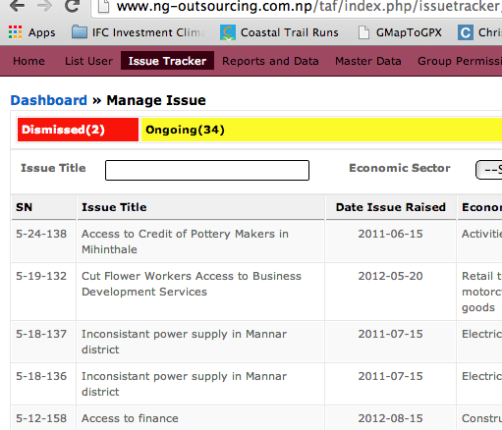
Step-by-step information gathering process
  One Issue – One record number

Slide 8
Step-by-step information gathering
  Identifying characteristics e.g.:
  Original date issue first raised
  Geographical location (province / district)
  Economic sector(s)
  Stakeholder(s) responsible for raising issue
  Vertical linkages that may connect the issue up to the national or even regional level
  Etc.

Slide 9
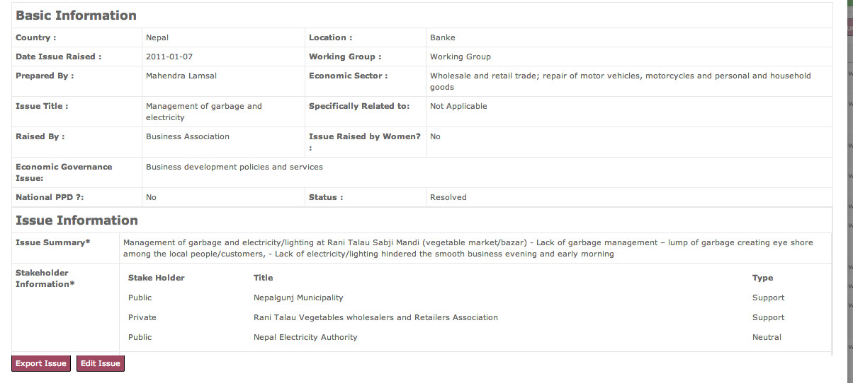

Slide 10
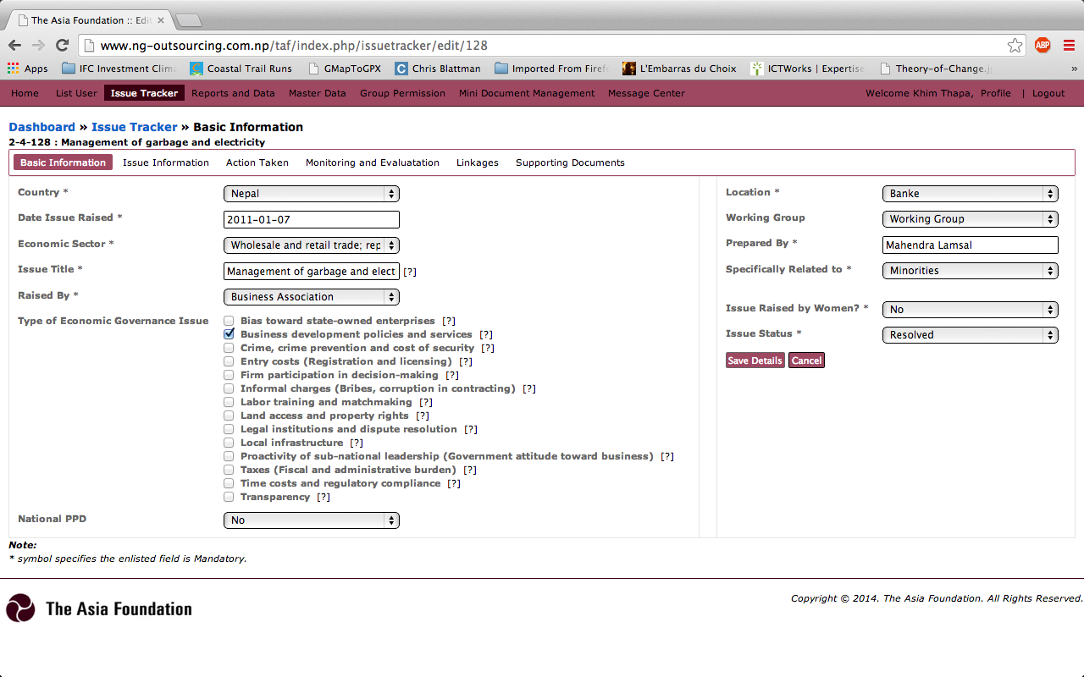

Slide 11
Step-by-step information gathering
  Detailed information about the issue itself is gathered:
  Broad and specific issue area
  Stakeholders involved and potentially affected (not just stakeholder raising it)
  Proposed recommendations and desired changes
  Expected outcomes and expected benefits.
  Indicators to measure impact

Slide 12
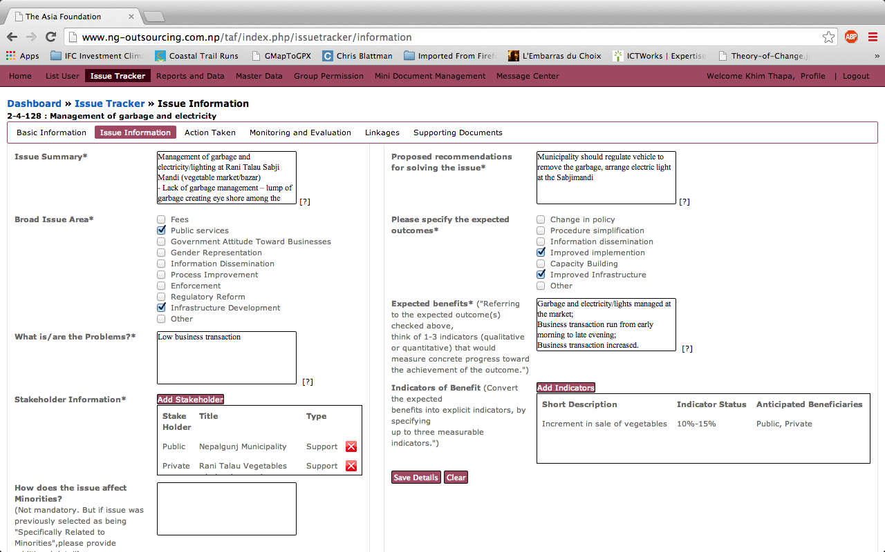

Slide 13
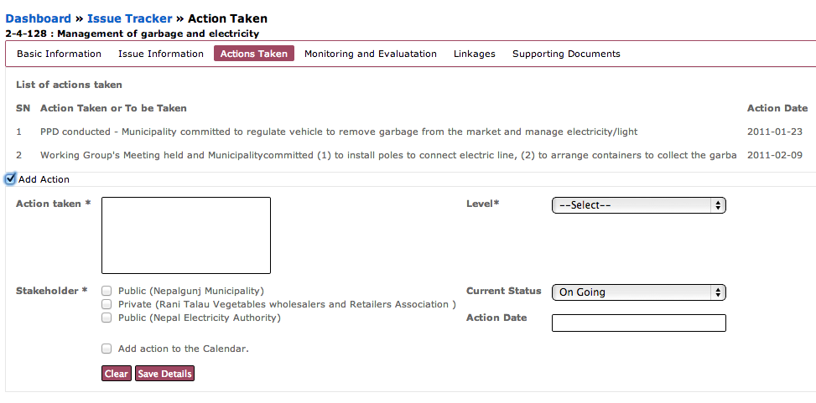
  Record-keeper for ongoing activities / chart progress

Slide 14
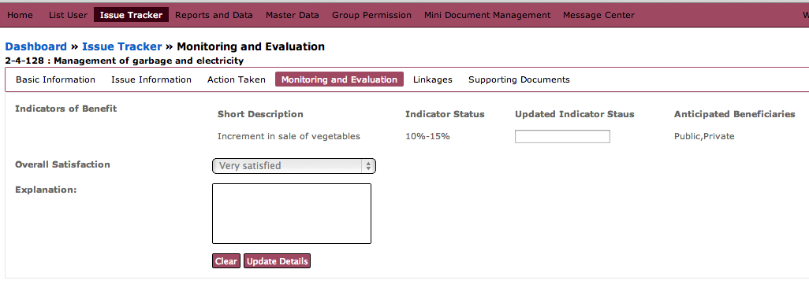
  M&E tab
  track progress towards issue objectives in real-time
  Compare anticipated resolution and current status.

Slide 15
Reporting
  Running reports and statistics by sector, location, issue type, etc.
  Cross comparisons across provinces, districts, etc.
  Sharing of working groups’ experiences across several locations.
  Potential for comparisons across borders, if relevant.

Slide 16
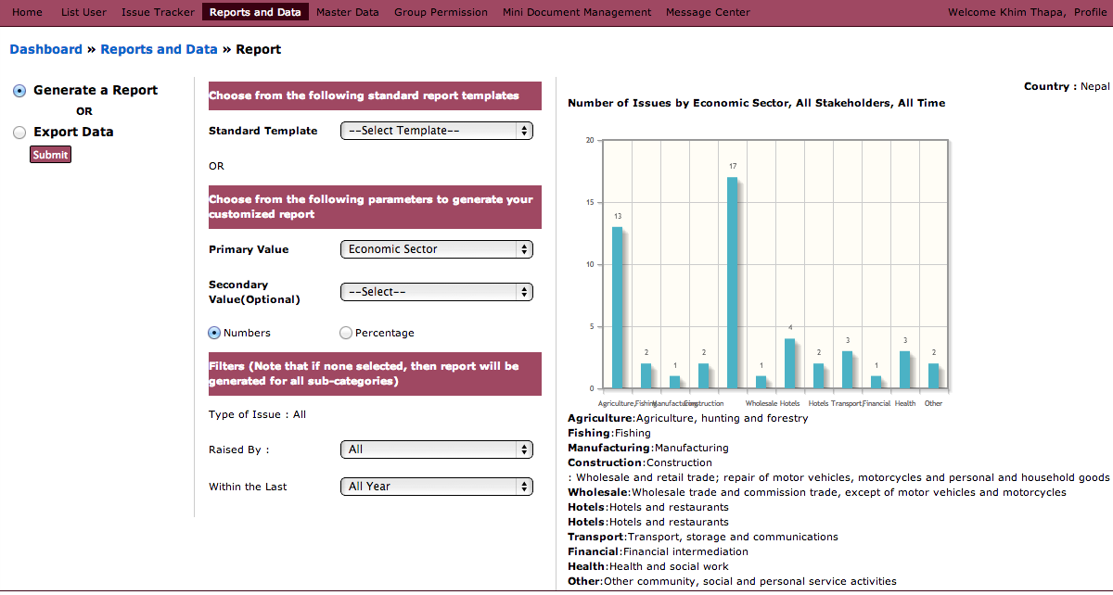

Slide 17
URL: http://www.ng-outsourcing.com.np/taf

Slide 18
Complementary M&E Tools
  One of several complementary tools for monitoring and evaluating the progress of PPDs and working groups
  Other M&E tools to complement/supplement the Issue Tracker may include:
    Evaluation wheel
    Quarterly evaluation surveys
    Spider diagrams
    Theory of Change

Slide 19
Concluding remarks
  Currently Issue Tracker is still in beta mode.
  Needs users to test it, report bugs, and provide feedback.
  Eventually could be SMS-enabled using services like FrontlineSMS, etc.
  Contact person at TAF: Katherine Loh
  katherine.loh@asiafoundation.org

Slide 20
Thank you

